Slide 1
Life Cycle Assessment of Novel Technical Routes to Valorise Municipal Solid Waste Incineration (MSWI) Bottom Ash (BA):
From the research labs to environmental assessment models
Giovanna SAUVE, Hugo LUCAS, Patricia R. MONICH, Enrico BERNARDO, Bernd FRIEDRICH, Karel VAN ACKER

Slide 2
Outline of the Presentation
Introduction
Life cycle assessment
  Goal and scope definition
  The new scenarios
  Life cycle inventory
  Life cycle impact assessment
Conclusions

Slide 3
Outline of the Presentation
Introduction
Life cycle assessment
  Goal and scope definition
  The new scenarios
  Life cycle inventory
  Life cycle impact assessment
Conclusions

Slide 4
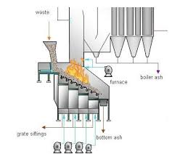
Incineration and Management of MSWI BA: State of the Art
Solid residues from MSWI
25%-30% wt
Bottom ash = 80%
Fe metals (8-10%)
NFe metals (2-5%)
Minerals (80-85%)
Unburned organics (<1%)
[Hykš & Hjelmar, 2018]
Mechanical treatment
Landfill/ Aggregates

Slide 5
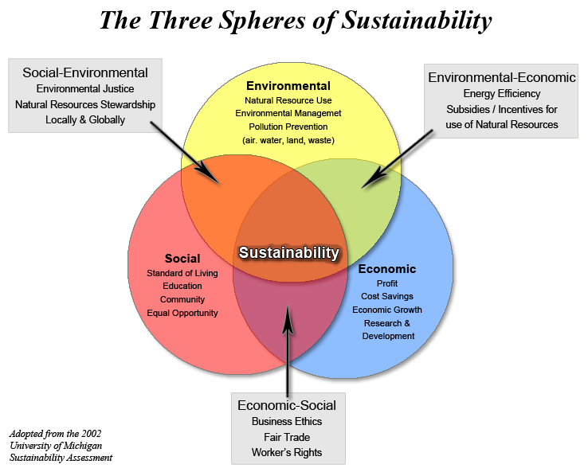
What does it mean sustainability?
© 2019 Vanderbilt University

Slide 6
Outline of the Presentation
Introduction
Life cycle assessment
  Goal and scope definition
  The new scenarios
  Life cycle inventory
  Life cycle impact assessment
Conclusions

Slide 7
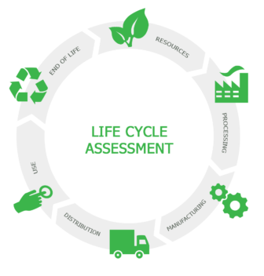
Life cycle assessment (LCA)
Emissions to air
Energy
Emissions to soil
Emissions to water
Materials
Waste

Slide 8
The Life Cycle Assessment
Goal of the study: Assess the environmental impact of MSWI BA valorization routes with focus on resource recovery potential, quality of materials and their marketability
Functional Unit (FU): Treatment of 1 kg of MSWI BA
Data was derived from
    Related studies: Lucas et al. (2017, 2018) ; Rabelo Monich et al. (2018)
    Literature
    Ecoinvent database v3.3
Life cycle assessment framework
Goal and Scope definition
Interpretation
Inventory analysis
Impact assessment

Slide 9
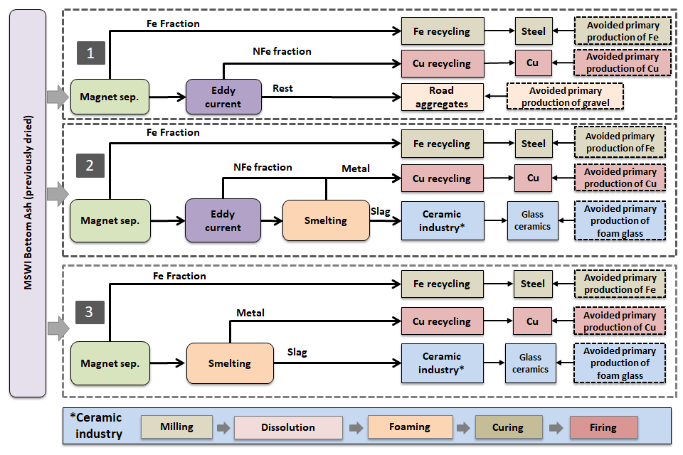
New valorization routes for MSWI BA

Slide 10
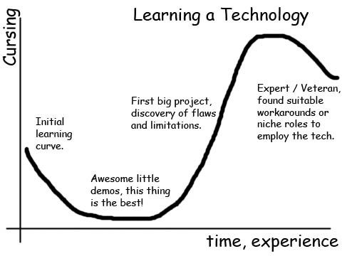
Challenge 1: Upscaling data from lab to commercial scale (I)
Technology development curve
The processes included in scenarios are at different levels of the learning curve:
  Overestimation
  Need to optimize
Mass and energy balances can differ significantly
Development
Experience
Lab scale
Full industrial scale: average
Pilot scale = transition
Full industrial scale: BAT

Slide 11


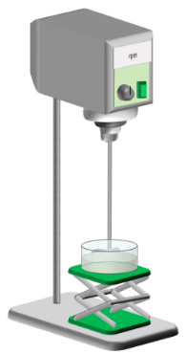
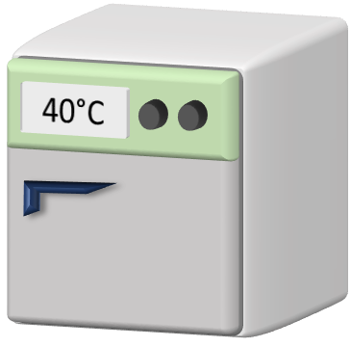
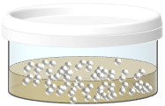
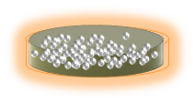
Challenge 2: Upscaling data from lab to commercial scale (II)
Dissolution
Foaming
Curing
Firing
11
Rabelo Monich et al. (2018), Lucas et al. (2018)
Available Frameworks
Linear relation for stoichiometric amounts
Heating energy = f(reactor, reaction parameters, heating element)
Optimized values depending on scaling factor

Slide 12
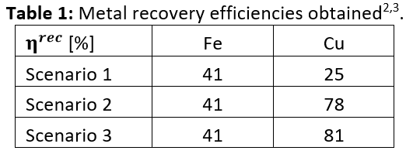
Challenge 2: Quality of materials and substitution factors
Magnetic separation Eddy Current Separator
Quality of metals extracted in MSWI Bottom Ash
Good quality
Metal lost in BA
Metal lost in BA
Aluminium strongly polluted
Iron strongly oxidised ( need to be cleaned)
Low efficiency
[Lucas H. et al, 2018]

Slide 13
Life cycle impact assessment
Life cycle assessment framework
Goal and Scope definition
Interpretation
Inventory analysis
Impact assessment

Slide 14
Life cycle impact assessment
Midpoints
Ozone depletion
Substances
Human toxicity
Normalization
Radiation
Ozoneformation
Raw Materials
Land use
CO₂
VOC
P
SO²
NO_{x}
CFC
PAH
DDT
Particules form.
Climate change
Person Equivalent (PE)
Terr. ecotox
Terr. acidif.
Agr. land occ.
Urban. land occ.
Nat. land transf
Marine ecotox.
Marine eutr.
Freshwater eutr.
Freshw. Ecotox.
Fossil fuel cons
Mineral cons.
Uncertainty
Water cons.

Slide 15
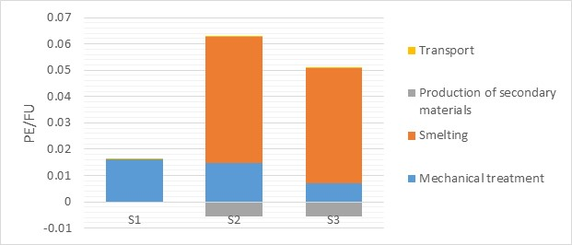
Life cycle impact assessment results (I)

Slide 16
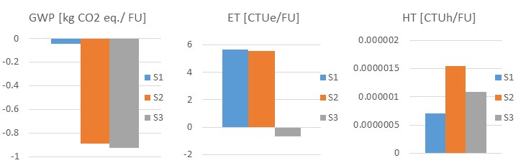
Life cycle impact assessment results (II)

Slide 17
Outline of the Presentation
Introduction
Life cycle assessment
  Goal and scope definition
  The new scenarios
  Life cycle inventory
  Life cycle impact assessment
Conclusions

Slide 18
Conclusions
Quality and marketability of recovered materials are key factors in the LCA of resource recovery processes
The quality of the materials also influences the optimal recovery processes to consider
Good communication between LCA practitioners and process experts could lead to better assessments and decision making
Resource recovery from MSWI BA leads to environmental savings (GWP, AP, AD)
Environmental impacts of processes (ET, HT) are affected by processing routes chosen, waste disposal
Further research would be required on the use phase and EoL of the products (aggregates and foam glass): leaching and recyclability potential

Slide 19

Thank you for your attention!

